Slide 1
APS Failure and Operational Data for Scania Trucks

Slide 2
Introduction
The dataset consists of data collected from heavy Scania trucks in everyday usage.
The system in focus is the Air Pressure system (APS) which generates pressurized air that is utilized in various functions in a truck, such as braking and gear changes.
The dataset’s positive class consists of component failures for a specific component of the APS system
The negative class consists of trucks with failures for components not related to the APS
Our goal – design classifiers
Notes:
is to design a classifier to predict whether a Scania truck has an APS failure based on some or all the provided attributes.

Slide 3
Preprocessing
Remove columns where over 5% of instance values are missing values
Remove columns where over 90% of instance values are zero
Change missing values to the mean of the column
Notes:
All the data has labeled p/n, so we don’t need to remove any rows
We have 170 predictors, which is too many for us to analysis. We remove cloumns ….., after that we have127,106 predictors

Slide 4
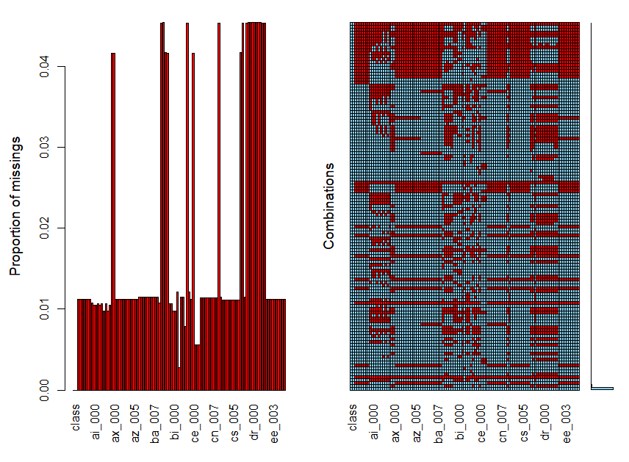
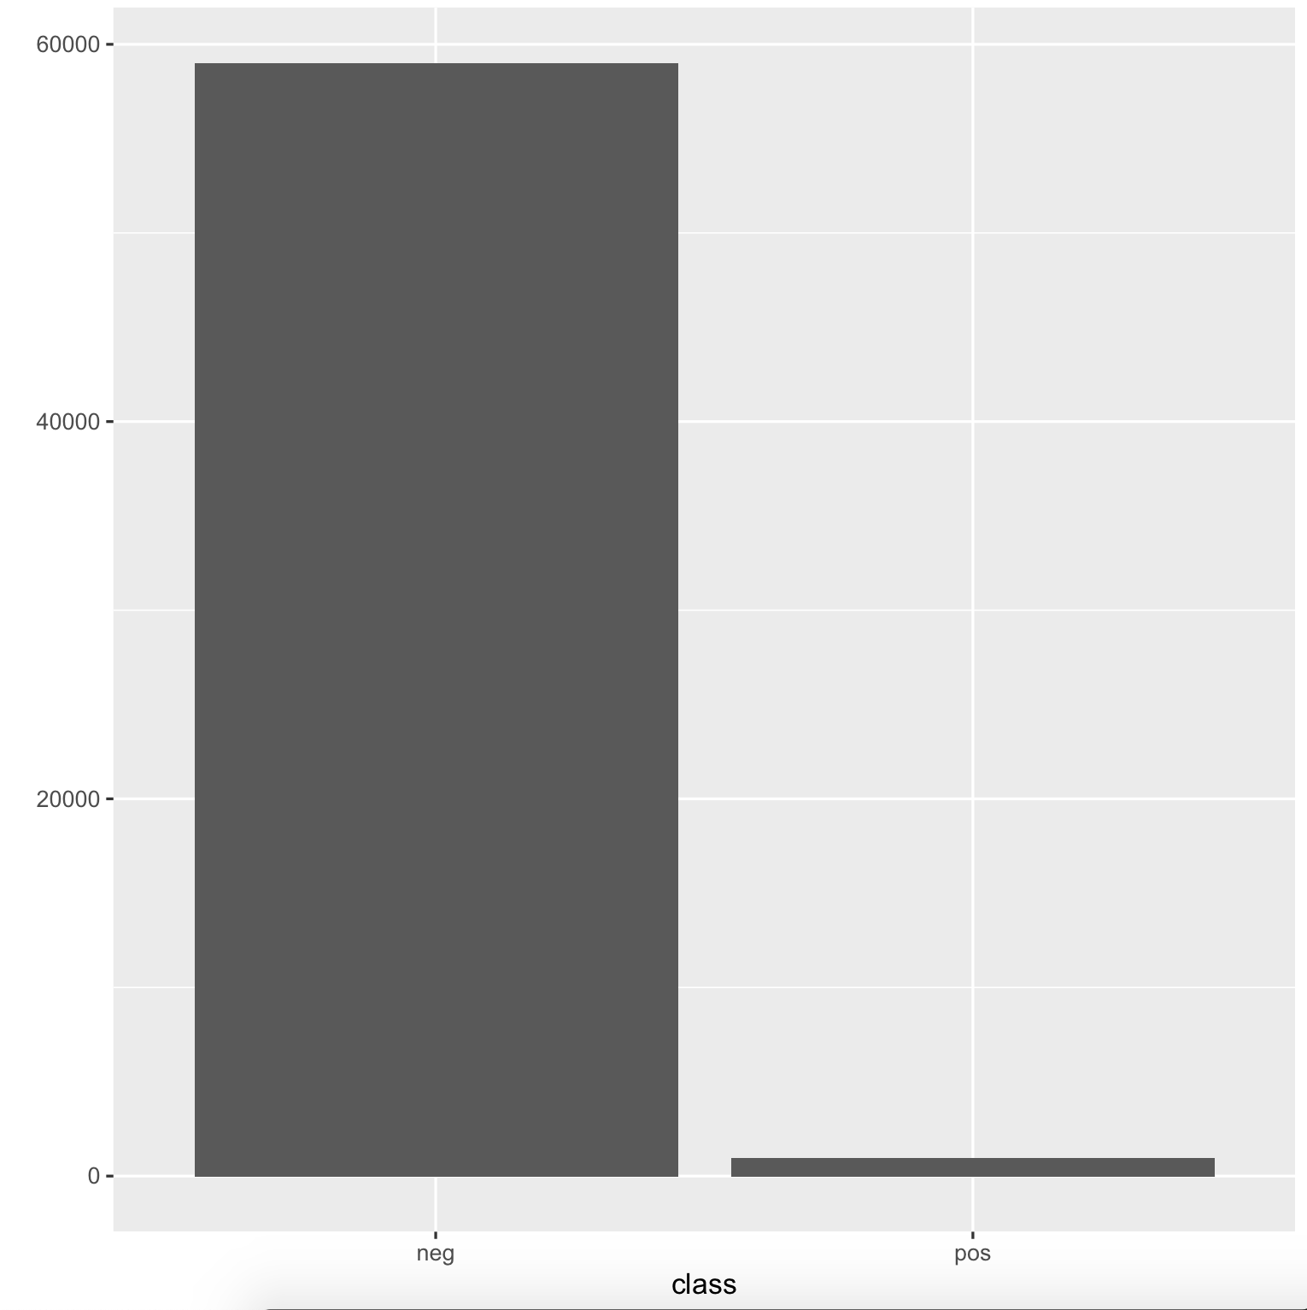
Data Visualization
Notes:
To fill the missing values, the patterns of missing values were checked first.
The plot indicated that we can assume the values in the training dataset are missing at random while the columns where the missing values were removed in the last step.
Even though the PCA didn’t apply to the training set, it was used as a robust imputation method to fill all the NAs.

Slide 5
Train & Test Split
Split the dataset into 60% training and 40% test with stratified split
# Split dataset 60% train and 40 % test
set.seed(3456)
trainIndex <- createDataPartition(data$class, p = .6, list = FALSE, times = 1)
train <- data[ trainIndex,]
test <- data[-trainIndex,]
Notes:
Explain brief of stratified split (split the negative with equal ration with the positive)

Slide 6
Methods
Naïve Bayes
Random Forest
Logistic Regression
Multilayer Perceptron
Decision Tree
Notes:
We used five methods to do the classification, nb, rf, lr, mlp and dt. We are using all the predictors after preprocessing to train the model, but we find some important predictors, we’ll talk about I lr.

Slide 7
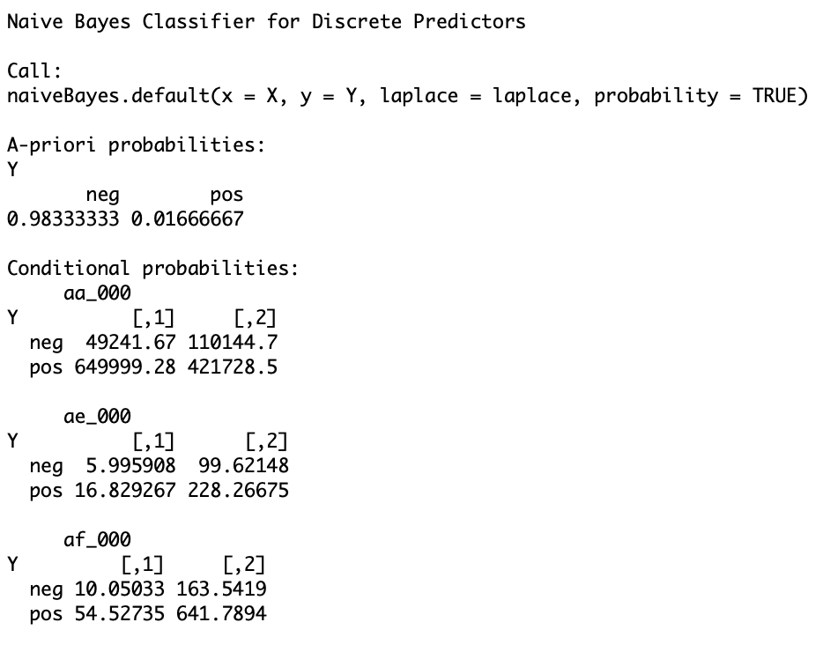

Methods Naïve Bayes

Slide 8
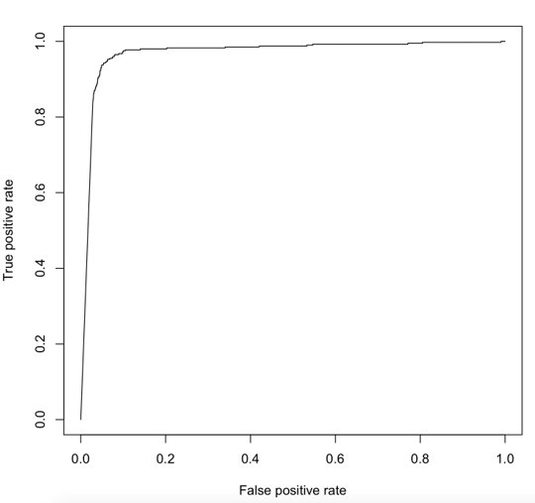
Results
Naïve Bayes
Accuracy rate: 96.59%
Recall: 82.25%
Precision: 31%
F1_score: 45.46%
Total cost: 37090
Predict\Actual | True | False
Positive | 341 | 759
Negative | 59 | 22841
Confusion matrix
Notes:
Recurrence model

Slide 9
Naïve Bayes
Strength :
Assume all predictors are independent --> Fast
Able to handle high-dimensional data
Weakness:
NOT all predictors are independent --> less accurate
Notes:
The assumption that all predictors are independent makes naive bayes very fast compared to complicated algorithms. It works well with high-dimensional data. The assumption makes naive bayes less accurate than complicated algorithms.

Slide 10
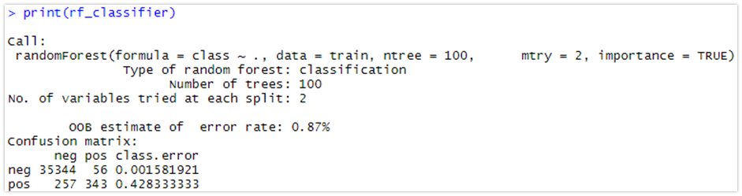
Methods Random Forest

Slide 11
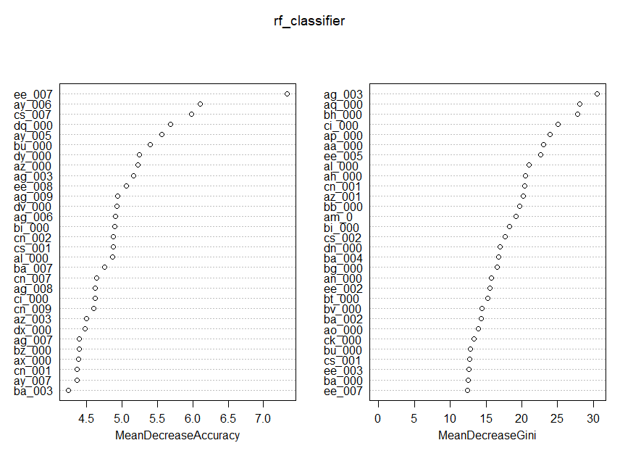
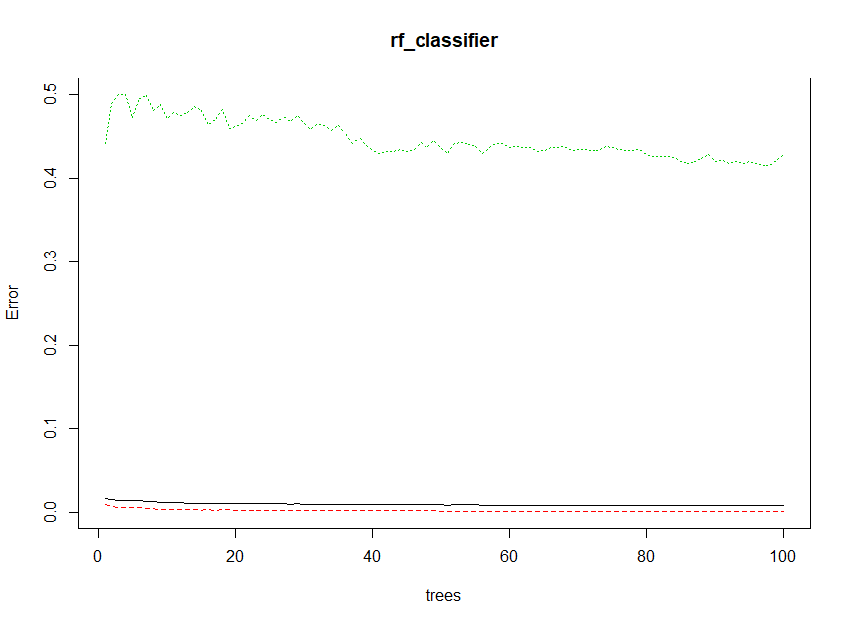
Results
Random Forest
Accuracy rate : 99.17 %
Recall : 60 %
Precision : 86.02 %
F1-Score : 70.69 %
Total cost : 80390
Confusion matrix
 | Predictions
Targets | 2 (Positive) | 1 (Negative)
2 (Positive) | 240 | 39
1 (Negative) | 160 | 23561
Notes:
The first plot on the lower left corner indicates the error for our different classes (colored) and out-of-bag samples displayed in black over the amount of trees.
Classes are in the same order as the results we get from print(model), so will be red=setosa and green=virginica.
As we can see the error seems to be lowest around 100 trees displayed in black line.
The nect plot ont the upper right corner is variable importance plot which is a critical output of the random forest algorithm. For each variable in our matrix it tells us how important that variable is in classifying the data. The plot shows each variable on the y-axis, and their importance on the x-axis. They are ordered top-to-bottom as most- to least-important.
The mean decrease in accuracy is a variable causes determined during the out of bag error calculation phase. The more the accuracy of the random forest decreases due to the exclusion (or permutation) of a single variable, the more important that variable is deemed, and therefore variables with a large mean decrease in accuracy are more important for classification of the data. The mean decrease in Gini coefficient is a measure of how each variable contributes to the homogeneity of the nodes and leaves in the resulting random forest. Each time a particular variable is used to split a node, the Gini coefficient for the child nodes are calculated and compared to that of the original node. The Gini coefficient is a measure of homogeneity from 0 (homogeneous) to 1 (heterogeneous). The changes in Gini are summed for each variable and normalized at the end of the calculation. Variables that result in nodes with higher purity have a higher decrease in Gini coefficient.
The most important result in this model is accuracy rate f1 score and total cost

Slide 12
Random Forests
Strength :
Can handle very large dataset relatively faster
Output importance of variable
Random forest can solve both type of problems that is classification and regression
Maintains accuracy when large proportion of the data are missing
Weakness:
Very little control on what the model does
Notes:
One of benefits of Random Forest which exists me most is, the power of handle large data sets with higher dimensionality. It can handle thousands of input variables and identity most significant variables so it is considered as one of the dimensionality reduction method. Further, the model outputs importance of variable, which can be a very handy feature.
Random forest can solve both type of problems that is classification and regression.
It has an effective method for estimating missing data and maintains accuracy when large proportion of the data are missing.
One of the weakness of Random forest is it feels like a black box approach for a statistical modelers we have very little control on what the model does. You can at best try different parameters and random seeds.

Slide 13
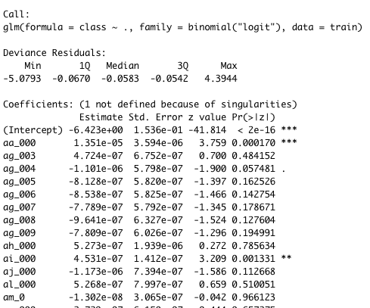
Methods Logistic Regression
Notes:
Please remember to mention the important predictors

Slide 14
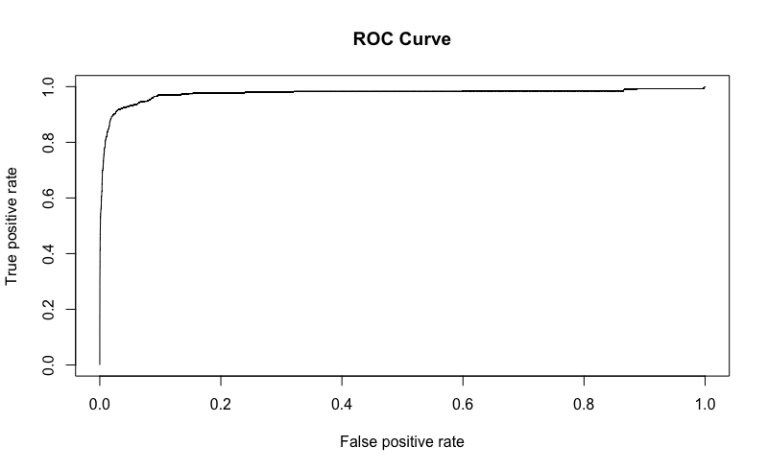
Results
Logistic Regression
Accuracy rate: 99.05%
Recall: 62.5%
Precision: 76.45%
F1_score: 68.78%
Total cost: 75770
Predict\Actual | Negative | Positive
Negative | 23523 | 150
Positive | 77 | 250
Confusion matrix

Slide 15
Logistic Regression
STRENGTHS
1. More informative output than others
2. Efficient to train
3. No scaling required
WEAKNESS
Assumption of linearity
2. Independent observations required
3. Used to predict discrete functions
4. Overfitting the model

Slide 16
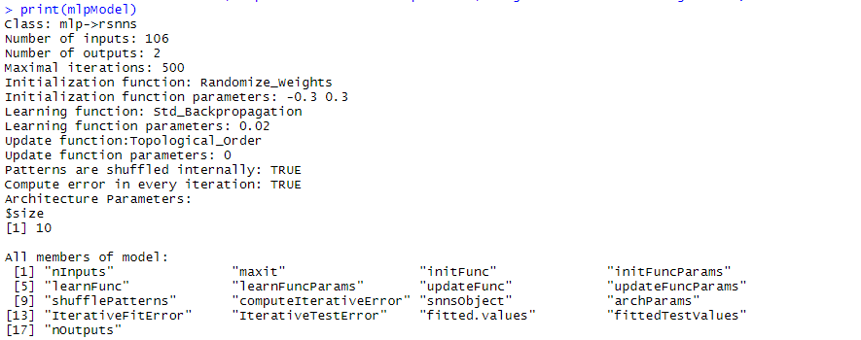
Methods Multi-Layer Perceptron
Notes:
Multi-Layer Perceptron is a form of Classification through Artificial Neural Network concepts.
Here is details of the MLP classifier.
As you can see the number of inputs is 106; these are all the attributes in our pre-processed dataset except for the class attribute as that is the target of the model.
Number of outputs are two. The maximal iterations is 500, the learning function parameters is 0.02 and the size of hidden layers is 10.
The learning function used standard Back Propagation.
Values of the model are checked after each iteration to determine an error in the weighting of the connections.
If there is an error, it will feed back that error through the network for the next iteration and the algorithm adjusts the weights of all connections based off the information provide from the error.
All other variables are the default

Slide 17
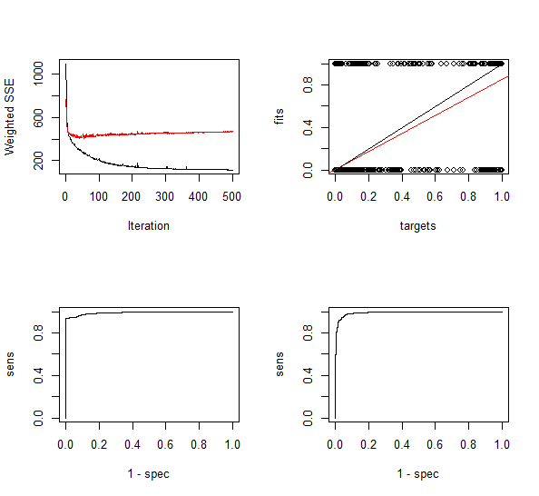
Methods Multi-Layer Perceptron Visualization
Notes:
Here are Four Visualizations of the MLP Model used.
The top left plot shows the Weighted Sum of squared errors.
Its an example of the Jumping Frog Syndrome, where a frog jumps half the distance of that it jumped before
and the total distance will never reach twice the first distance jumped.
The top right plot shows the RegressionError between the predictTestSet and the targetTest data in trainset.
The bottom two are ROC plots.
Overall Accuracy is determined at one cut-point,
so ROC plots are used to various cut points.
Left ROC plot shows the trade off between false positives from the fitted.values of the mlpModel versus the true positive of the trainset$targetsTrain. The higher the area under the curve, the greater the skill of the model. And plot shows a very large area under the curve.
The right ROC plot shows the trade off between false positives of the predictTestSet and the true positive from the trainset$targetsTest. It also has a large area under the curve but is a more rounded shape between 0.0 and 0.1 on the x-axis.

Slide 18
Results
Multi-Layered Perceptron
Accuracy rate: 99.27%
Recall: 79.38%
Precision: 69.97%
F1_score: 74.38%
Total cost: 34090
Predict/Actual | Negative | Positive
Negative | 23571 | 66
Positive | 109 | 254
Notes:
Based of the information in the Confusion Matrix in the bottom right we can calculate the Accuracy, Recall, Precision, F1_Score and Total Cost.
For this example of the model:
the accuracy rate is 99.27%
the recall is 79.38%
the Precision is 69.97%
F1_score is 74.38%
and a Total cost of 34090

Slide 19
Multi-Layered Perceptron
STRENGTHS
Ideal for complex training problems
Each layer has adaptive weights
All attribute values could be put into numeric values which made it easy to model
Suited for large number of data points
Once modelled, quick to execute predictions
WEAKNESS
More iterations mean more training time needed.
Data needs to be inputted in a specific way.
Relies heavily on the training data.
A blackbox approach
Notes:
Like All approaches MLP has its advantages and disadvantages
STRENGTHS
Ideal for complex training problems
Each layer has adaptive weights adjusting from Back Propagation which in turn leads to a more accurate training of the model.
all attribute values could be put into numeric values which made it easy to model
Well Suited for large number of data points
once the model was trained it was quick to execute predictions
WEAKNESS
More iterations mean more training time needed.
the mlp function required the data to be inputted in a certain way. Couldn't used the train dataset made in the pre-processed for training.
Relies heavily on the training data. the training dataset was too small so the whole known dataset was used.
Like Random Forest this was a blackbox approach. A very trial and error sort of process to finding a good classifier.

Slide 20
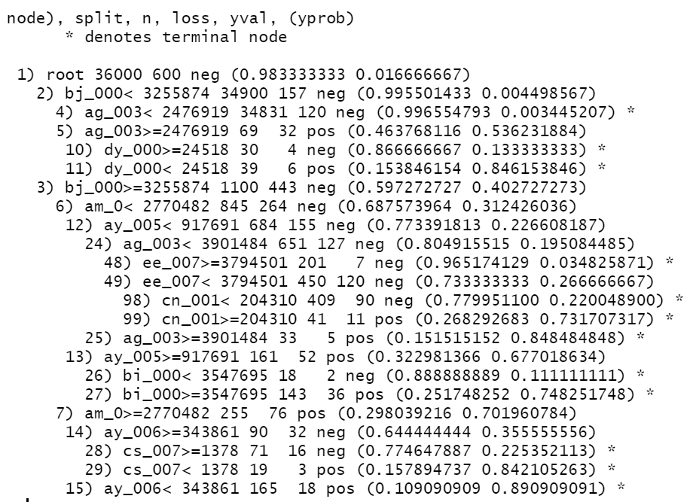
Decision Tree
# Fit decision tree to training dataset
dtree_classifier <- rpart(class ~.,
data = train, method = "class")
print(dtree_classifier)

Slide 21
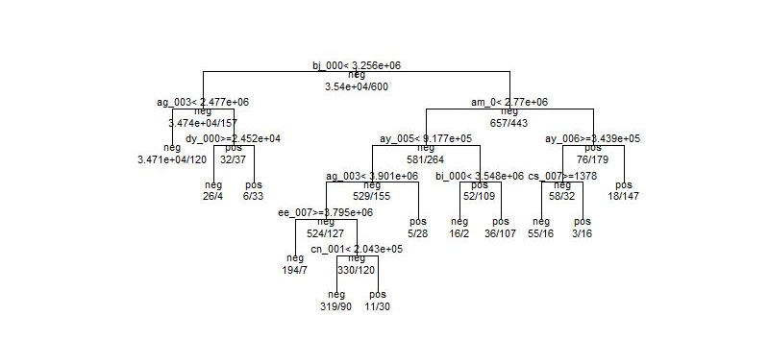
Visualizing Decision Tree

Slide 22
Results
Decision Tree
Predict/Actual | Negative | Positive
Negative | 23519 | 167
Positive | 81 | 233
Accuracy rate: 98.97 %
Recall: 58.25 %
Precision: 74.20 %
F1_score: 65.26 %
Total cost: 84310

Slide 23
Decision Tree Approach
STRENGTHS
Does not require normalization of data
Does not require scaling of data
Missing values in the data also does not affect the process of building decision tree
Intuitive and easy to explain to stakeholders
WEAKNESS
Higher time to train the model
More Complex
Relatively expensive

Slide 24
Discussion & Conclusion
Method | Accuracy rate | F1-Score | Cost
Naïve Bayes | 96.59% | 45.46% | 37090
Random Forest | 99.17% | 70.69% | 80390
Logistic Regression | 99.05% | 68.78% | 75770
Multilayer Perceptron | 99.27% | 74.38% | 34090
Decision Tree | 98.97% | 65.26% | 84310
Notes:
Point out the highest and smallest for each column.
Compare the Accuracy rate in parallel with cost.
Why smaller cost doesn’t always mean better accuracy(e.g. NAÏVE BAYES).
Why MLP is better than the other model.

Slide 25
References
Medium. 2020. Top 5 Advantages And Disadvantages Of Decision Tree Algorithm. [online] Available at: <https://medium.com/@dhiraj8899/top-5-advantages-and-disadvantages-of-decision-tree-algorithm-428ebd199d9a> [Accessed 10 June 2020].
Kumar, N., 2019. Advantages And Disadvantages Of Logistic Regression In Machine Learning. [online] Theprofessionalspoint.blogspot.com. Available at: <http://theprofessionalspoint.blogspot.com/2019/03/advantages-and-disadvantages-of.html> [Accessed 10 June 2020].

